Slide 1
Lecture 2
Numerical differentiation Errors

Slide 2
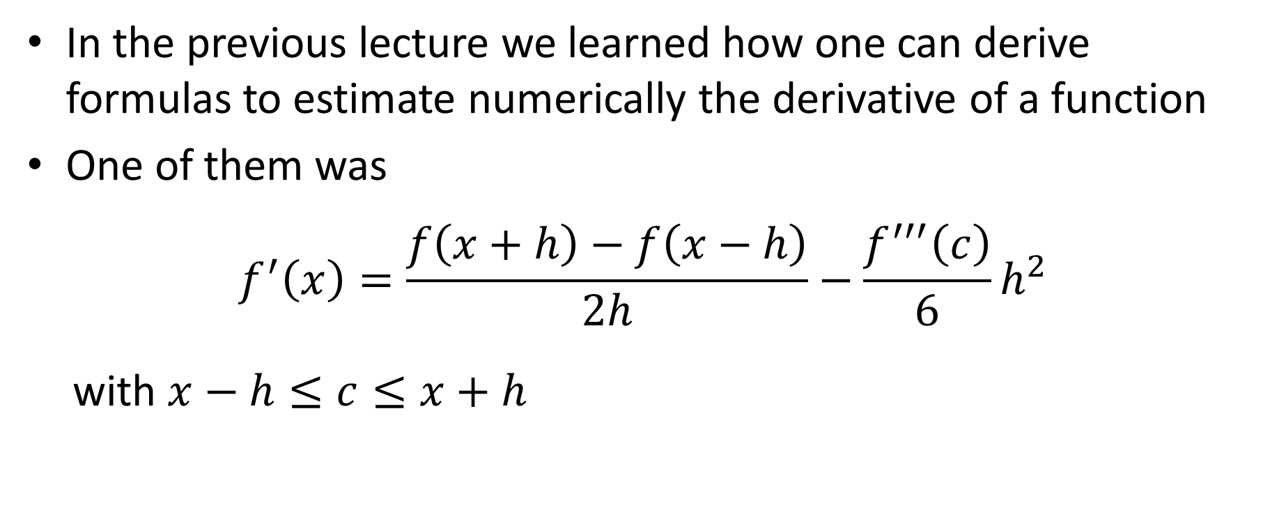
Introduction
In the previous lecture we learned how one can derive formulas to estimate numerically the derivative of a function
One of them was
$$f^{′}\left(x\right)=\frac{f\left(x+h\right)−f\left(x−h\right)}{2h}−\frac{f^{′′′}\left(c\right)}{6}h^{2}$$
with $x−h≤c≤x+h$
Notes:
In the previous lecture we learned how one can derive formulas to estimate numerically the derivative of a function
We used for this Taylor series expansions
One of them was the so-called three-point centered-difference formula:
$$f^{′}\left(x\right)=\frac{f\left(x+h\right)−f\left(x−h\right)}{2h}$$
Based on the Taylor series expansion we could determine the order of the truncation error. In the present case we found a truncation error of second order in h.

Slide 3
Introduction
We mentioned as well that such formulas may become very sensitive to round-off errors
In this lecture we are going to do one case study to illustrate this
Notes:
We noted that such formulas are very sensitive to round-off errors
In the present lecture we will study this aspect in more details

Slide 4
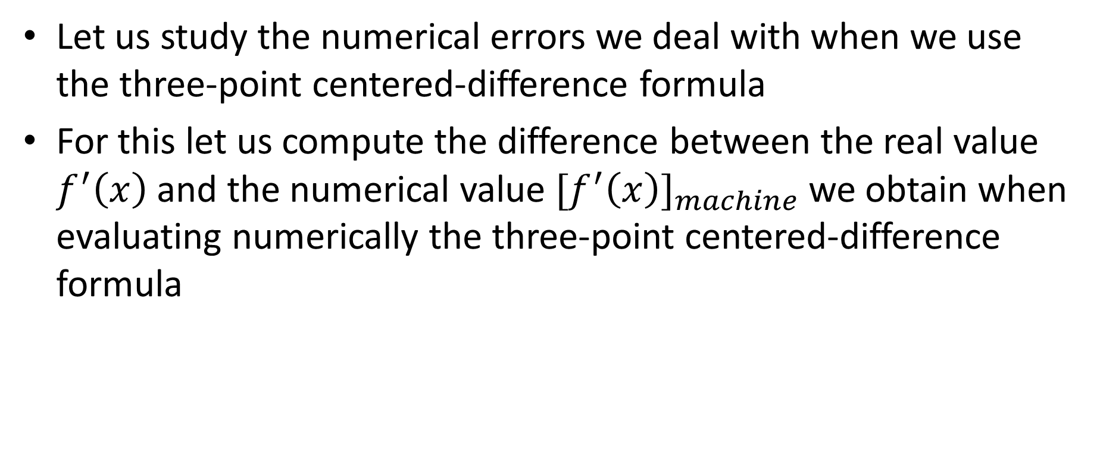
Numerical errors
Let us study the numerical errors we deal with when we use the three-point centered-difference formula
For this let us compute the difference between the real value $f^{′}\left(x\right)$ and the numerical value ${{[f}^{′}\left(x\right)]}_{machine}$ we obtain when evaluating numerically the three-point centered-difference formula
Notes:
To study the effect of round-off errors and truncation errors we use the three-point centered-difference formula
We will compute the difference between the real value $f^{′}\left(x\right)$ and the numerical value ${{[f}^{′}\left(x\right)]}_{machine}$
The real value $f^{′}\left(x\right)$ is the number we would obtain if we would be able to evaluate the derivative with no truncation and no round-off error.
The numerical value ${{[f}^{′}\left(x\right)]}_{machine}$ is the number we obtain when evaluating numerically the three-point centered-difference formula

Slide 5
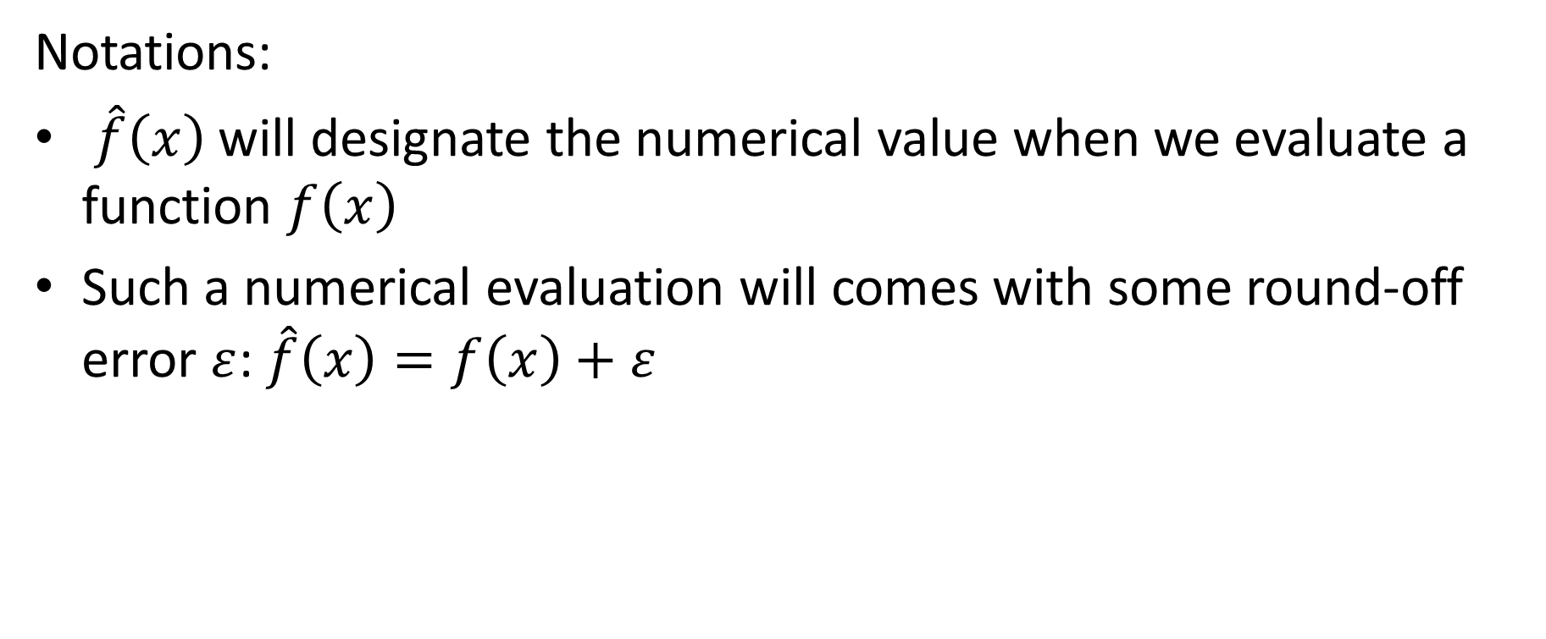
Numerical errors
Notations:
$\hat{f}\left(x\right)$ will designate the numerical value when we evaluate a function $f\left(x\right)$
Such a numerical evaluation will comes with some round-off error $ε$: $\hat{f}\left(x\right)=f\left(x\right)+ε$
Notes:
In the coming calculations we use two notations
First:
$\hat{f}\left(x\right)$ will designate the numerical value when we evaluate a function $f\left(x\right)$
Second, $ε$ will designate the round-off error.
Consequently we can write: $\hat{f}\left(x\right)=f\left(x\right)+ε$
Keep in mind that f(x) is the value of the function we would obtain if we could evaluate it without any round-off error
Recall from the first lesson, where we discussed round-off errors, that a function can never be evaluated free of round-off errors, as we never calcaulte with an infinite number of digits.
You may want to quickly review the lecture on round-off errors from lesson 1 in case you forgot about these concepts

Slide 6
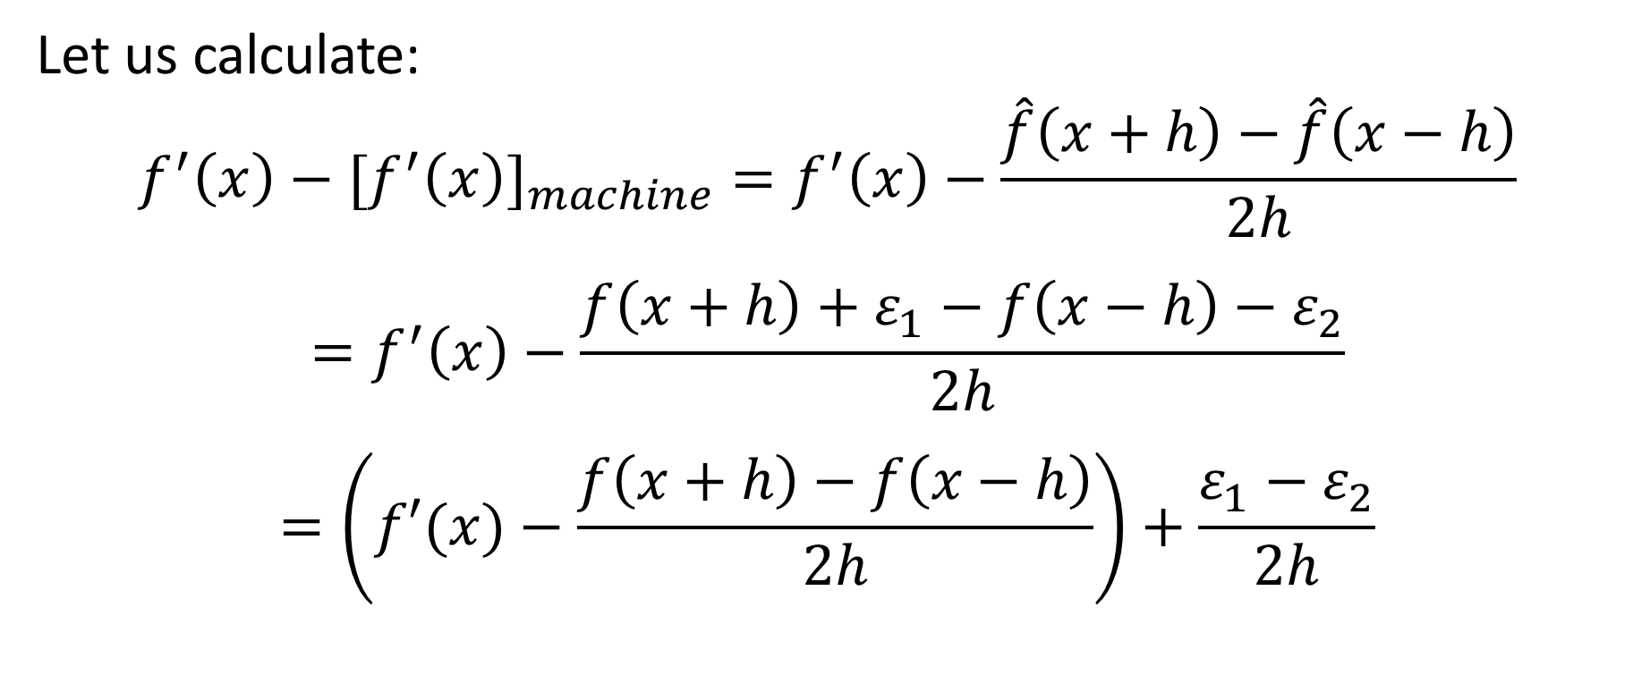
Numerical errors
Let us calculate:
$$f^{′}\left(x\right)−{{[f}^{′}\left(x\right)]}_{machine}=f^{′}\left(x\right)−\frac{\hat{f}\left(x+h\right)−\hat{f}\left(x−h\right)}{2h}$$
$$=f^{′}\left(x\right)−\frac{f\left(x+h\right)+ε_{1}−f\left(x−h\right)−ε_{2}}{2h}$$
$$=\left(f′(x)−\frac{f\left(x+h\right)−f\left(x−h\right)}{2h}\right)+\frac{ε_{1}−ε_{2}}{2h}$$
Truncation error
Round-off error
Notes:
Let us start our calculations
We have:
$$f^{′}\left(x\right)−{{[f}^{′}\left(x\right)]}_{machine}=f^{′}\left(x\right)−\frac{\hat{f}\left(x+h\right)−\hat{f}\left(x−h\right)}{2h}$$
By calculating the difference between the true value of the derivative and the one we obtain by evaluating it numerically with the three-point centered-difference formula, we obtain the total error. Recall that the total error is made of the sum of the truncation and the round-off error.
Our goal will be to identify these two contributions.
If we designate by $ε_{1}$ the round-off error we introduce by evaluating numerically f(x+h) and $ε_{2}$ the round-off error we introduce by evaluating f(x-h) we can continue our calculations and write:
$$f^{′}\left(x\right)−\frac{f\left(x+h\right)+ε_{1}−f\left(x−h\right)−ε_{2}}{2h}$$
Re-arranging slightly this expression allows us to write it as the difference of two expression
The first term is $f′(x)−\frac{f\left(x+h\right)−f\left(x−h\right)}{2h}$
This is the difference between the ideal value f’(x) and the expression we get when using the three-point centered-difference formula in a world free of round-off errors.
This is nothing than the truncation error
The second term is $\frac{ε_{1}−ε_{2}}{2h}$
This is nothing else than the round-off error.

Slide 7

Truncation error
We know already how much is the truncation error:
$$\left|f^{′}\left(x\right)−\frac{f\left(x+h\right)−f\left(x−h\right)}{2h}\right|=\left|\frac{f^{′′′}(c)}{6}h^{2}\right|≅\left|\frac{f^{′′′}(x)}{6}h^{2}\right|$$
Notes:
We know already how much is the truncation error of the three-point centered-difference formula
The number c is a number between x-h and x+h. As h will be small, we will approximate c by x and the truncation error can be approximated by $\frac{f^{′′′}(x)}{6}h^{2}$.

Slide 8

Round-off error
For the round-off error we estimate it as
$$\left|\frac{ε_{1}−ε_{2}}{2h}\right|≤\frac{{2ε}_{mach}}{2h}=\frac{ε_{mach}}{h}$$
Notes:
The round-off error contribution to the total error can be further estimated as well.
First recall that the round-off error is typically of the order of magnitude of the machine epsilon $ε_{mach}$, which is 10^(-16) if we use 16 digits in our calculations
Consequently
$$\left|\frac{ε_{1}−ε_{2}}{2h}\right|≤\frac{{2ε}_{mach}}{2h}$$
which simplifies to $\frac{ε_{mach}}{h}$

Slide 9







Total numerical error
$${E\left(h\right)=f}^{′}\left(x\right)−{{[f}^{′}\left(x\right)]}_{machine}≤\frac{\left|f^{′′′}\left(x\right)\right|}{6}h^{2}+\frac{ε_{mach}}{h}$$
$$E(h)$$
Truncation error $∝h^{2}$
$$h_{opt}={\left[\frac{3ε_{mach}}{\left|f^{′′′}\left(x\right)\right|}\right]}^{1/3}$$
Round-off error $∝h^{−1}$
$$h_{opt}$$
$$h$$
Notes:
In summary the total error E(h) will be smaller or equal than
$$\frac{\left|f^{′′′}\left(x\right)\right|}{6}h^{2}+\frac{ε_{mach}}{h}$$
Let us plot this error in function of the choice of h
E(h) is the sum of two terms
The first term, the truncation errors, is proportional to h square. This is because the used numerical approximation is a second order formula
The second term, the round-off errors, is inversely proportional to h.
The function E(h) will have a minimum in $h_{opt}$.
From the expression of E(h) it is simple to compute $h_{opt}$.
Try to do it as an exercise.
Simply search for the minimum of E(h) by looking for the zero of the first derivative of E(h).

Slide 10





Total numerical error
Truncation error $∝h^{2}$
$$E(h)$$
Round-off error
using more digits
Truncation error $∝h^{3}$
Minimal
achievable error
Round-off error $∝h^{−1}$
Lower minimal
achievable error
$$h$$
Notes:
There are a few important conclusions to draw form the expression and graph of E(h)
First: there is a minimal error one can achieve by using the three-point centered-difference formula
This minimum comes from the completion between truncation and round-off error
As you use smaller and smaller values of h, the truncation error decreases, but the round-off error increases.
Second: how can we reduce this smallest possible error we can achieve?
We need to reduce the contribution of either the truncation or the round-off errors
Truncation errors can be reduced by using a higher order method. In this case the contribution will decrease faster than h^2, for example in h cube.
A lower minimal achievable error results.
Round-off errors can be reduced by using more significant digits. In this case $ε_{mach}$ will become smaller
As in the previous case, we can get a smaller achievable error

Slide 11



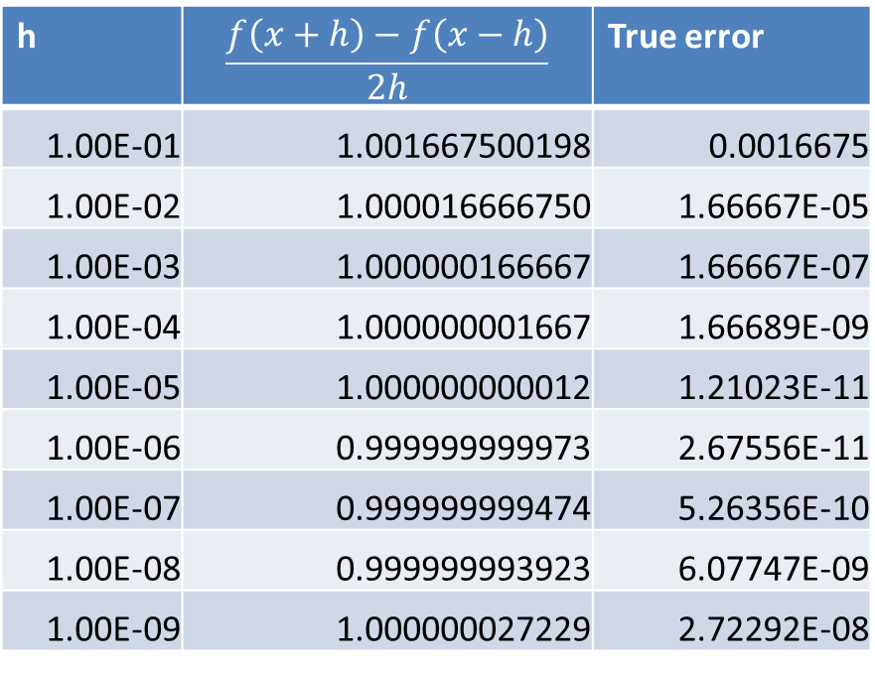
Example
Apply the three-point centered-difference formula to approximate the first derivative of $f\left(x\right)=e^{x}$ in $x=0$
h | $$\frac{f\left(x+h\right)−f\left(x−h\right)}{2h}$$ | True error
1.00E-01 | 1.001667500198 | 0.0016675
1.00E-02 | 1.000016666750 | 1.66667E-05
1.00E-03 | 1.000000166667 | 1.66667E-07
1.00E-04 | 1.000000001667 | 1.66689E-09
1.00E-05 | 1.000000000012 | 1.21023E-11
1.00E-06 | 0.999999999973 | 2.67556E-11
1.00E-07 | 0.999999999474 | 5.26356E-10
1.00E-08 | 0.999999993923 | 6.07747E-09
1.00E-09 | 1.000000027229 | 2.72292E-08
$$E(h)$$
$$h$$
Notes:
Let us apply our formula on an example
For this we use the function $e^{x}$ and we want to evaluate numerically with the three-point centered-difference formula the derivative in x=0
The exact value of the derivative in x=0 is 1.
We fill out the displayed table where we use different values of h
If we plot the true error in function of h, we get indeed a curve as we predicted by our theory
As predicted we get a minimal achievable error for an optimal value of h

Slide 12

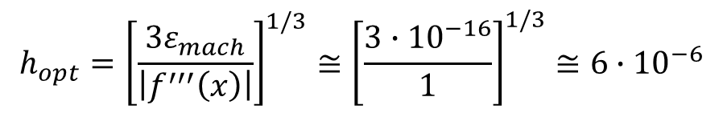
Example
Apply the three-point centered-difference formula to approximate the first derivative of $f\left(x\right)=e^{x}$ in $x=0$
$$E(h)$$
$$h_{opt}={\left[\frac{3ε_{mach}}{\left|f^{′′′}\left(x\right)\right|}\right]}^{1/3}≅{\left[\frac{3∙{10}^{−16}}{1}\right]}^{1/3}≅6∙{10}^{−6}$$
$$h_{opt}$$
$$h$$
Notes:
Applying our theory we can predict the value of $h_{opt}$ to be about $6∙{10}^{−6}$
Comparing with our plot, we get a very good agreement.
Of course, for actual practical application our formula is not very useful.
Indeed, to compute $h_{opt}$ we need the third derivative of f.
If we use a numerical formula to estimate the first derivative of f , one will not know the third derivative.
The point of the presented development is not to be able to compute $h_{opt}$
The point is to realize the competition between truncation and round-off error contributing to the total error.
This point will come back when we discuss numerical integration and numerical solutions of initial value problems.

Slide 13
Summary
The total error when estimating numerically the derivative of a function has two contributions:
Truncation error
Round-off error
Both contribution compete resulting in a minimal possible achievable error
As one uses smaller values of h, the truncation error decreases, but the round-off errors increase
Truncation errors are reduced by using higher order algorithms
Round-off errors are reduced by using more digits in calculations
Notes:
Let us summarize the key findings
- The total error when estimating numerically the derivative of a function has two contributions:
Truncation error
Round-off error
- Both contribution compete resulting in a minimal possible achievable error
As one uses smaller values of h, the truncation error decreases, but the round-off errors increase
- Truncation errors are reduced by using higher order algorithms
- Round-off errors are reduced by using more digits in calculations

